Slide 1
Faster all-pairs optimal electric car routing
Dani Dorfman
MPI für Informatik
Haim Kaplan Robert E. Tarjan Mikkel Thorup Uri Zwick

Slide 2
Routing an electric car
$$G=\left(V,E,g,B\right), g:E→ℝ, B∈\left[0,∞\right).$$
Battery capacity limit is $B$.
Edge gains represent charge gained by traversing the edge.
$$B=13$$
$$−1$$
$$6$$
$$5$$
$$−4$$
$$−3$$
$$−2$$
$$−7$$
$$−2$$
Notes:
The problem is not symmetric single source != single target

Slide 3
Routing an electric car
$$G=\left(V,E,g,B\right), g:E→ℝ, B∈\left[0,∞\right).$$
Battery capacity limit is $B$.
Edge gains represent charge gained by traversing the edge.
$$B=13$$
$$−1$$
$$6$$
$$5$$
$$−4$$
$$−3$$
$$−2$$
$$−7$$
$$−2$$
Notes:
The problem is not symmetric single source != single target

Slide 4
Routing an electric car
$$G=\left(V,E,g,B\right), g:E→ℝ, B∈\left[0,∞\right).$$
Battery capacity limit is $B$.
Edge gains represent charge gained by traversing the edge.
$$B=13$$
$$−1$$
$$6$$
$$5$$
$$−4$$
$$−3$$
$$−2$$
$$−7$$
$$−2$$
Notes:
The problem is not symmetric single source != single target

Slide 5
Routing an electric car
$$G=\left(V,E,g,B\right), g:E→ℝ, B∈\left[0,∞\right).$$
Battery capacity limit is $B$.
Edge gains represent charge gained by traversing the edge.
$$B=13$$
$$−1$$
$$6$$
$$5$$
$$−4$$
$$−3$$
$$−2$$
$$−7$$
$$−2$$
Notes:
The problem is not symmetric single source != single target

Slide 6
Routing an electric car
$$G=\left(V,E,g,B\right), g:E→ℝ, B∈\left[0,∞\right).$$
Battery capacity limit is $B$.
Edge gains represent charge gained by traversing the edge.
$$B=13$$
$$−1$$
$$6$$
$$5$$
$$−4$$
$$−3$$
$$−2$$
$$−7$$
$$−2$$
Notes:
The problem is not symmetric single source != single target

Slide 7
Routing an electric car
$$G=\left(V,E,g,B\right), g:E→ℝ, B∈\left[0,∞\right).$$
Battery capacity limit is $B$.
Edge gains represent charge gained by traversing the edge.
$$B=13$$
$$−1$$
$$6$$
$$5$$
$$−4$$
$$−3$$
$$−2$$
$$−7$$
$$−2$$
Notes:
The problem is not symmetric single source != single target

Slide 8
Routing an electric car
$$G=\left(V,E,g,B\right), g:E→ℝ, B∈\left[0,∞\right).$$
Battery capacity limit is $B$.
Edge gains represent charge gained by traversing the edge.
$$B=13$$
$$−1$$
$$6$$
$$5$$
$$−4$$
$$−3$$
$$−2$$
$$−7$$
$$−2$$
Notes:
The problem is not symmetric single source != single target

Slide 9
Routing an electric car
$$G=\left(V,E,g,B\right), g:E→ℝ, B∈\left[0,∞\right).$$
Battery capacity limit is $B$.
Edge gains represent charge gained by traversing the edge.
$$B=13$$
$$−1$$
$$6$$
$$5$$
$$−4$$
$$−3$$
$$−2$$
$$−7$$
$$−2$$
Notes:
The problem is not symmetric single source != single target

Slide 10
Routing an electric car
$$G=\left(V,E,g,B\right), g:E→ℝ, B∈\left[0,∞\right).$$
Battery capacity limit is $B$.
Edge gains represent charge gained by traversing the edge.
For $s,t∈V,$ compute:
$α_{a}(s,t)$, starting with $a$ charge at $s$, maximize charge at $t$.
$β_{b}(s,t)$, the minimal initial charge at $s$ required to reach $t$ with at least $b$ charge.
Notes:
Hence, unlike many problems stop when encounter negative cycles, we explore them.

Slide 11
Routing an electric car
Single-Target
Single-Source
Lemma: $α_{a}^{G}\left(s,t\right)=B−β_{B−a}^{G^{t}}(t,s)$
$$β_{0}^{G^{t}}(⋅,s)$$
$$β_{0}^{G^{t}}(t,⋅)$$
$$s$$
$$1$$
$$x$$
$$−1$$
$$t$$
$$α_{B}\left(s,t\right)=B−1$$
Single-Source
Single-Target
$$s$$
$$−1$$
$$x$$
$$1$$
$$t$$
$$α_{B}\left(s,t\right)=B$$
$$α_{B}(s,⋅)$$
$$α_{B}(⋅,t)$$
For $s,t∈V,$ compute:
$α_{a}(s,t)$, starting with $a$ charge at $s$, maximize charge at $t$.
$β_{b}(s,t)$, the minimal initial charge at $s$ required to reach $t$ with at least $b$ charge.
Notes:
Hence, unlike many problems stop when encounter negative cycles, we explore them.

Slide 12
Positive cycles
Let $v_{1}…v_{k}$ be a positive cycle.
Lemma:
1) If $B=∞$, then $∃i_{0}$ such that the cycle can be traversed from $v_{i_{0}}$ with zero initial charge.
2) If $B<∞$, then $∃i_{0},j_{0}$ such that, starting at $v_{i_{0}}$ with zero initial charge, we can reach $v_{j_{0}}$ with full charge.
.
.
.
$$g_{3}$$
…
$$v_{3}$$
.
$$g_{2}$$
$$v_{2}$$
$$g_{1}$$
$$g_{k}$$
$$v_{k}$$
$$v_{1}$$

Slide 13
Positive cycles
Let $v_{1}…v_{k}$ be a positive cycle.
Lemma:
1) If $B=∞$, then $∃i_{0}$ such that the cycle can be traversed from $v_{i_{0}}$ with zero initial charge.
$$\sum_{j≤i}{g_{j}}$$
2) If $B<∞$, then $∃i_{0},j_{0}$ such that, starting at $v_{i_{0}}$ with zero initial charge, we can reach $v_{j_{0}}$ with full charge.
.
.
.
$$g_{3}$$
…
$$i$$
$$v_{3}$$
.
$$g_{2}$$
$$v_{2}$$
$$g_{1}$$
$$g_{k}$$
$$v_{k}$$
$$v_{1}$$

Slide 14
Positive cycles
Let $v_{1}…v_{k}$ be a positive cycle.
entry
Lemma:
1) If $B=∞$, then $∃i_{0}$ such that the cycle can be traversed from $v_{i_{0}}$ with zero initial charge.
$$\sum_{j≤i}{g_{j}}$$
2) If $B<∞$, then $∃i_{0},j_{0}$ such that, starting at $v_{i_{0}}$ with zero initial charge, we can reach $v_{j_{0}}$ with full charge.
.
.
.
$$g_{3}$$
…
$$i$$
(entry , exit)
$$v_{3}$$
.
$$g_{2}$$
$$v_{2}$$
$$g_{1}$$
$$g_{k}$$
$$v_{k}$$
$$i_{0}$$
$$v_{1}$$

Slide 15
Structure of optimal paths
$$B=∞$$
$$C$$
$$s$$
$$x$$
$$t$$
$$P_{1}$$
$$P_{2}$$
$$P_{3}$$
$$P_{k}$$
$$P_{k+1}$$
$$B<∞$$
$$s$$
$$x_{1}$$
$$C_{1}$$
$$y_{1}$$
$$x_{2}$$
$$C_{2}$$
$$y_{2}$$
$$x_{k}$$
$$C_{k}$$
$$y_{k}$$
$$t$$

Slide 16
Computing $α_{B}(⋅,⋅)$ ESA 2023
 | single-source | single-target | all-pairs
No positive cycles | $$\begin{matrix}O(mn) \\ O{\left(m+n\log{n}\right)}^{∗}\end{matrix}$$ |  | $$O(mn+n^{2}\log{n})$$
Positive cycles, $$"B=∞"$$ |  |  | $$O(mn+n^{2}\log{n})$$
Positive cycles, $B<∞$ | $$O(mn+n^{2}\log{n})$$
Notes:
Mention that everything is a reduction to this table

Slide 17
Computing $α_{B}(⋅,⋅)$ ESA 2023
 | single-source | single-target | all-pairs
No positive cycles | $$\begin{matrix}O(mn) \\ O{\left(m+n\log{n}\right)}^{∗}\end{matrix}$$ |  | $$O(mn+n^{2}\log{n})$$
Positive cycles, $$"B=∞"$$ |  |  | $$O(mn+n^{2}\log{n})$$
Positive cycles, $B<∞$ | $$O(mn+n^{2}\log{n})$$ |  | $$\tilde{O}(n^{3.5})$$
This talk
Notes:
Mention that everything is a reduction to this table

Slide 18
Shortcutting – Standard Shortest Paths
$$t$$
$$s$$
$$8$$
$$3$$
$$−2$$
$$−12$$
$$−1$$
$$5$$
$$4$$
$$−4$$
$$−6$$
$$−2$$
$$6$$
$$2$$
$$1$$
$$2$$
Breaks down for energetic paths
$$3$$
Notes:
The problem is not symmetric single source != single target

Slide 19
Shortcutting – Standard Shortest Paths
$$t$$
$$s$$
$$8$$
$$3$$
$$−2$$
$$B=11$$
$$−12$$
$$−1$$
$$5$$
$$4$$
$$−4$$
$$−6$$
$$−2$$
$$6$$
$$2$$
$$1$$
Charge goes below $0$ - illegal
Breaks down for energetic paths
$$3$$
Notes:
The problem is not symmetric single source != single target

Slide 20
Shortcutting – Standard Shortest Paths
$$1$$
$$t$$
$$s$$
$$8$$
$$3$$
$$−2$$
$$B=10$$
$$−12$$
$$−1$$
$$5$$
$$4$$
$$−4$$
$$−6$$
$$−2$$
$$6$$
$$2$$
$$1$$
Some charge is truncated because of the capacity limit $B$
Breaks down for energetic paths
$$3$$
Notes:
The problem is not symmetric single source != single target

Slide 21
Shortcutting – Energetic Paths
Use a safe path structure for shortcutting.
Monotone Paths
Ascending path
Descending path
$$v_{2}$$
$$v_{8}$$
$$v_{1}$$
$$v_{7}$$
$$v_{4}$$
$$v_{5}$$
$$v_{6}$$
$$v_{3}$$
$$v_{7}$$
$$v_{2}$$
$$v_{3}$$
$$v_{5}$$
$$v_{6}$$
$$v_{1}$$
$$v_{4}$$
$$v_{8}$$
$$(a)$$
$$(b)$$
$$3$$
Notes:
The problem is not symmetric single source != single target

Slide 22
Shortcutting – Energetic Paths
Theorem: In $\tilde{O}\left(n^{3.5}\right)$ time we can compute a table $D\left[⋅\right][⋅]$ s.t $∀u,v∈V$:
1. For every simple monotone path $P$ from $u$ to $v$: $D\left[u\right]\left[v\right]≥g(P)$.
2. There exists a monotone path $P$ from $u$ to $v$ $s.t D\left[u\right]\left[v\right]=g(P)$.
Ascending path
Descending path
$$v_{2}$$
$$v_{8}$$
$$v_{1}$$
$$v_{7}$$
$$v_{4}$$
$$v_{5}$$
$$v_{6}$$
$$v_{3}$$
$$v_{7}$$
$$v_{2}$$
$$v_{3}$$
$$v_{5}$$
$$v_{6}$$
$$v_{1}$$
$$v_{4}$$
$$v_{8}$$
$$(a)$$
$$(b)$$
$$3$$
Notes:
The problem is not symmetric single source != single target

Slide 23
Edge-Bounded Paths & Funnels
Additional path structures we utilize.
Edge-Bounded
Funnel
$$v$$
$$v$$
$$w$$
$$w$$
$$u$$
$$u$$
Every subpath is edge-bounded
$$3$$
Notes:
The problem is not symmetric single source != single target

Slide 24
Edge-Bounded Paths & Funnels
$$3\frac{1}{3}$$
Theorem: In $\tilde{O}\left(n \right)$ time we can compute a table $B\left[⋅\right][⋅]$ s.t $∀u,v,w∈V$:
1. For every simple funnel $P$ from $uv$ to $w$: $B\left[uv\right]\left[w\right]≥g(P)$.
2. There exists an edge-bounded path $P$ from $uv$ to $w$ $s.t B\left[uv\right]\left[w\right]=g(P)$.
Edge-Bounded
Funnel
$$v$$
$$v$$
$$w$$
$$w$$
$$u$$
$$u$$
Every subpath is edge-bounded
$$3$$
Notes:
The problem is not symmetric single source != single target

Slide 25
Computing all monotone paths
Observation: Every monotone path contains a short (length $≤3$) monotone subpath.
$$3$$
Notes:
The problem is not symmetric single source != single target

Slide 26
Computing all monotone paths
Observation: Every monotone path contains a short (length $≤3$) monotone subpath.
Shortcut..
$$3$$
Notes:
The problem is not symmetric single source != single target

Slide 27
Computing all monotone paths
Observation: Every monotone path contains a short (length $≤3$) monotone subpath.
Shortcut..
$$3$$
Notes:
The problem is not symmetric single source != single target

Slide 28
Computing all monotone paths
Observation: Every monotone path contains a short (length $≤3$) monotone subpath.
Shortcut..
$$3$$
Notes:
The problem is not symmetric single source != single target

Slide 29
Computing all monotone paths
Observation: Every monotone path contains a short (length $≤3$) monotone subpath.
Shortcut..
$$3$$
Notes:
The problem is not symmetric single source != single target

Slide 30
Computing all monotone paths
Observation: Every monotone path contains a short (length $≤3$) monotone subpath.
Shortcut..
$$3$$
Notes:
The problem is not symmetric single source != single target

Slide 31
Computing all monotone paths
Observation: Every monotone path contains a short (length $≤3$) monotone subpath.
Shortcut..
$$3$$
Notes:
The problem is not symmetric single source != single target

Slide 32
Computing all monotone paths
Observation: Every monotone path contains a short (length $≤3$) monotone subpath.
Shortcut..
$$3$$
Notes:
The problem is not symmetric single source != single target

Slide 33
Computing all monotone paths
Observation: Every monotone path contains a short (length $≤3$) monotone subpath.
Shortcut..
$$3$$
Notes:
The problem is not symmetric single source != single target

Slide 34
Computing all monotone paths
Observation: Every monotone path contains a short (length $≤3$) monotone subpath.
Shortcut..
$$3$$
Notes:
The problem is not symmetric single source != single target

Slide 35
Computing all monotone paths
Observation: Every monotone path contains a short (length $≤3$) monotone subpath.
Shortcut..
$$3$$
Notes:
The problem is not symmetric single source != single target

Slide 36
Computing all monotone paths
Trivial Deterministic Algorithm – Repeat the process $n$ times. $\tilde{O}(n^{4})$
Shortcut..
$$3$$
Notes:
The problem is not symmetric single source != single target

Slide 37
Bad Instances
$$3$$
Notes:
The problem is not symmetric single source != single target

Slide 38
Bad Instances
$$3$$
Notes:
The problem is not symmetric single source != single target

Slide 39
Bad Instances
$$3$$
Notes:
The problem is not symmetric single source != single target

Slide 40
Bad Instances
$$3$$
Notes:
The problem is not symmetric single source != single target

Slide 41
Bad Instances
funnel
funnel
$$3$$
Notes:
The problem is not symmetric single source != single target

Slide 42
Bad Instances
Observation: Short-shortcuts are intertwined with the funnels
By Markov, if after $\sqrt{n}$ iterations the original path was not reduced to a single edge, then:
In at least $0.5\sqrt{n}$ iterations the path has at most $2\sqrt{n}$ funnels.
$$3$$
Notes:
The problem is not symmetric single source != single target

Slide 43
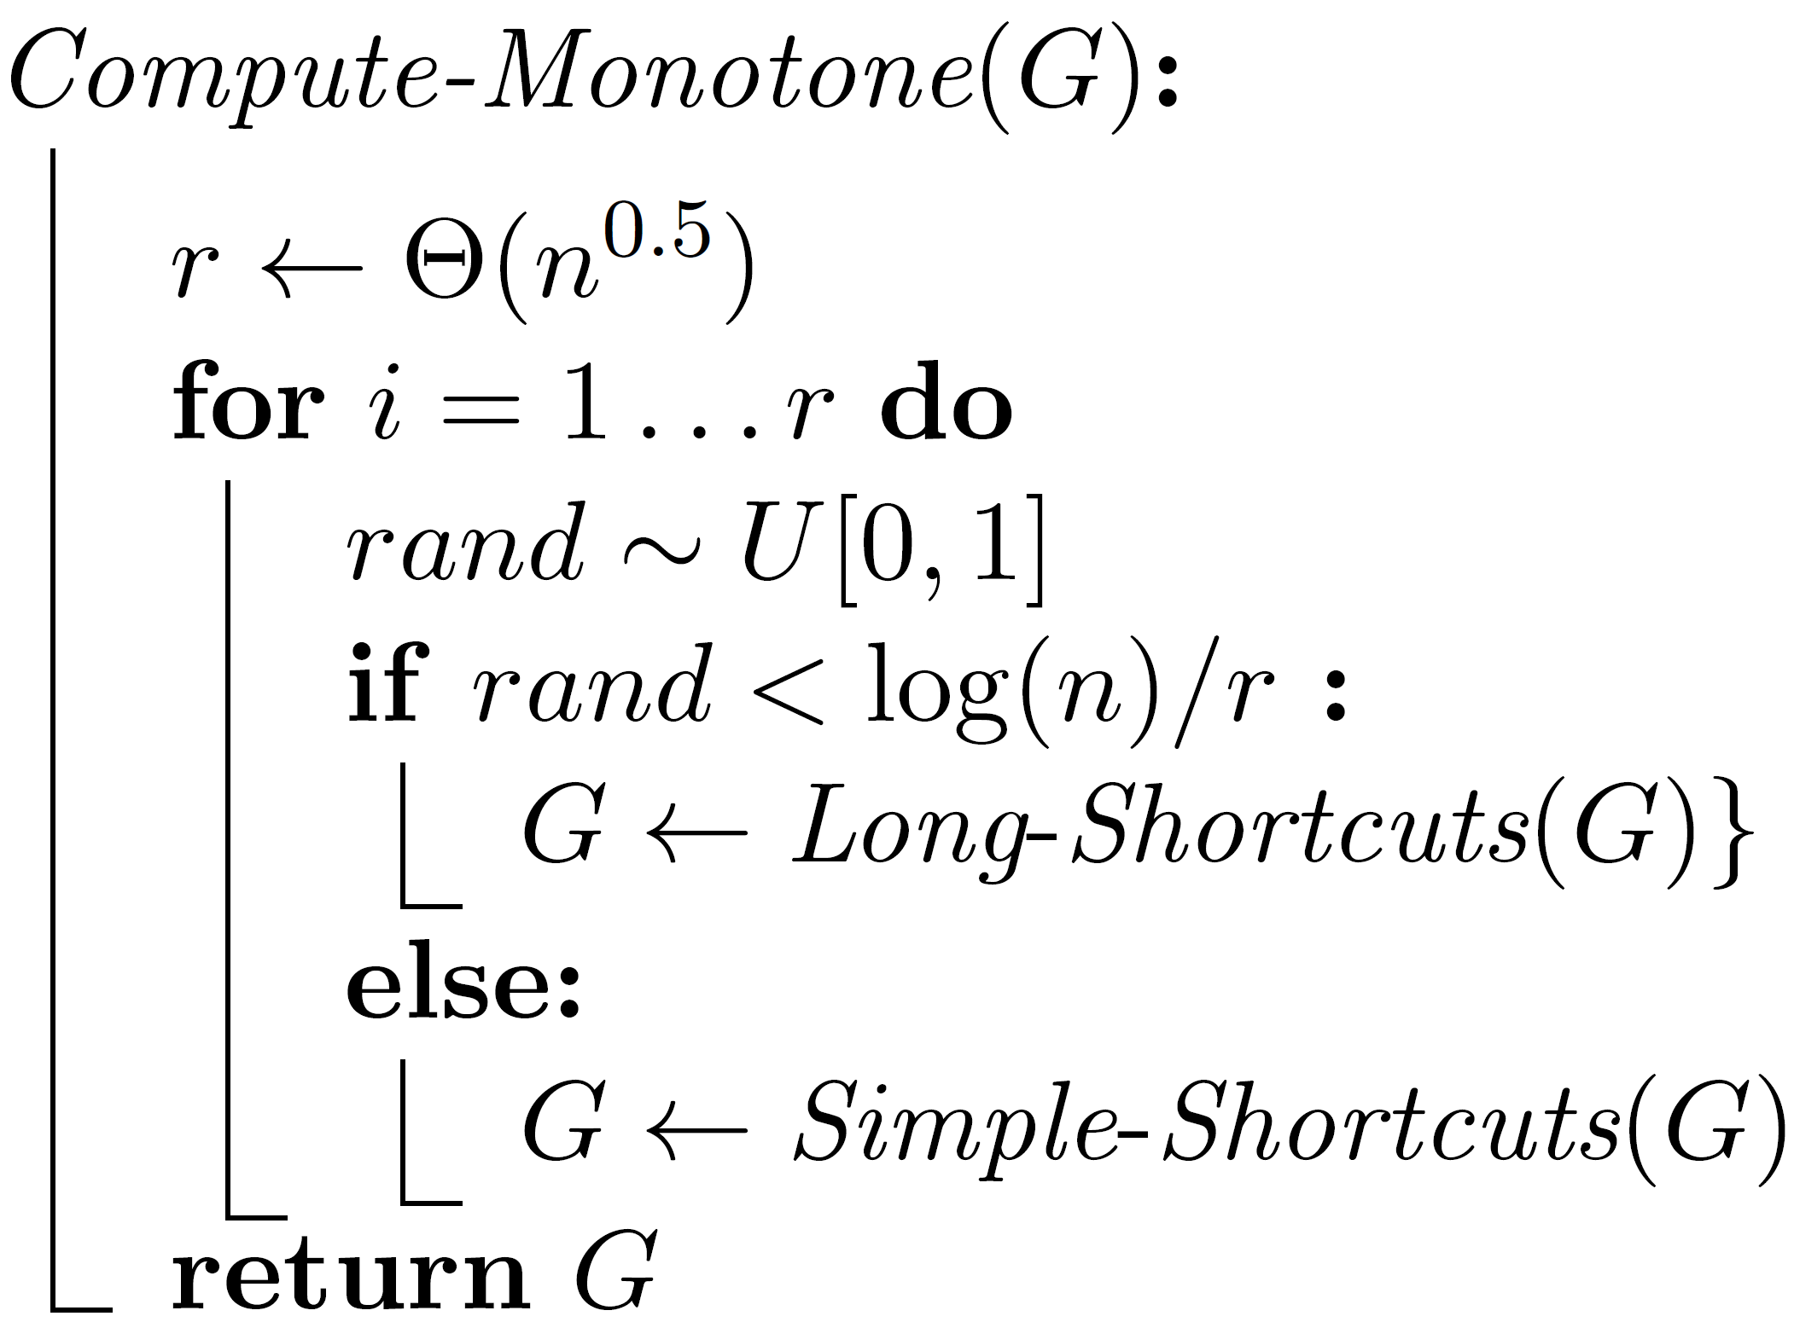
Algorithm
$$3$$
Notes:
The problem is not symmetric single source != single target

Slide 44
Finding long shortcuts
Take an edge-bonded path and extend it by a single edge.
$$v$$
$$w$$
$$u$$
$$y$$

Slide 45
Finding long shortcuts
Take an edge-bonded path and extend it by a single edge.
$$v$$
$$y$$
$$w$$
$$u$$
Q1. Which edge-bounded paths should we compute?
Q2. How to compute them?
A2. Start by computing all funnels (the table $B\left[⋅\right][⋅]),$ then perform concatenations

Slide 46
Concatenations
Concatenate edge-bounded paths if the concatenation is edge-bounded.
$$U$$
$$u$$
$$∈$$
$$w$$
$$z$$
$$b$$
$$v$$
Let $U⊆V$. $Concat(G,B,U)$ concatenates every edge-bounded path starting at $u∈U$ with every possible edge-bounded path.
$$\tilde{O}(n^{3}\left|U\right|)$$
$$∀u∈U,v,z∈V.$$
$$B\left[uv\right]\left[z\right]=\max_{w,b∈V}{B\left[uv\right]\left[w\right]+B\left[wb\right][z]}$$
$$3$$
Notes:
The problem is not symmetric single source != single target

Slide 47
Long shortcuts algorithm
Assume the monotone path has at most $2\sqrt{n}$ funnels.
Intuitively
Done using concatenations
Pick a vertex $u∈V.$
Work: #funnels
Reward: path length
Compute the edge-bounded path “induced” by $u$.
Extend the path by one edge and get a long shortcut.
$$3$$
Notes:
The problem is not symmetric single source != single target

Slide 48
Long shortcuts algorithm
Assume the monotone path has at most $2\sqrt{n}$ funnels.
Algorithm
For $i=1…\log{\sqrt{n}:}$
Compute edge-bounded paths
$U_{i}=Sample\left(V, p=\frac{1}{\sqrt{n}}⋅\frac{1}{2^{i}}\right)$
Perform $Concat\left(G,B,U_{i}\right) 2^{i}$ times
1.
Extend the generated paths by one edge.
$$3$$
Notes:
The problem is not symmetric single source != single target

Slide 49
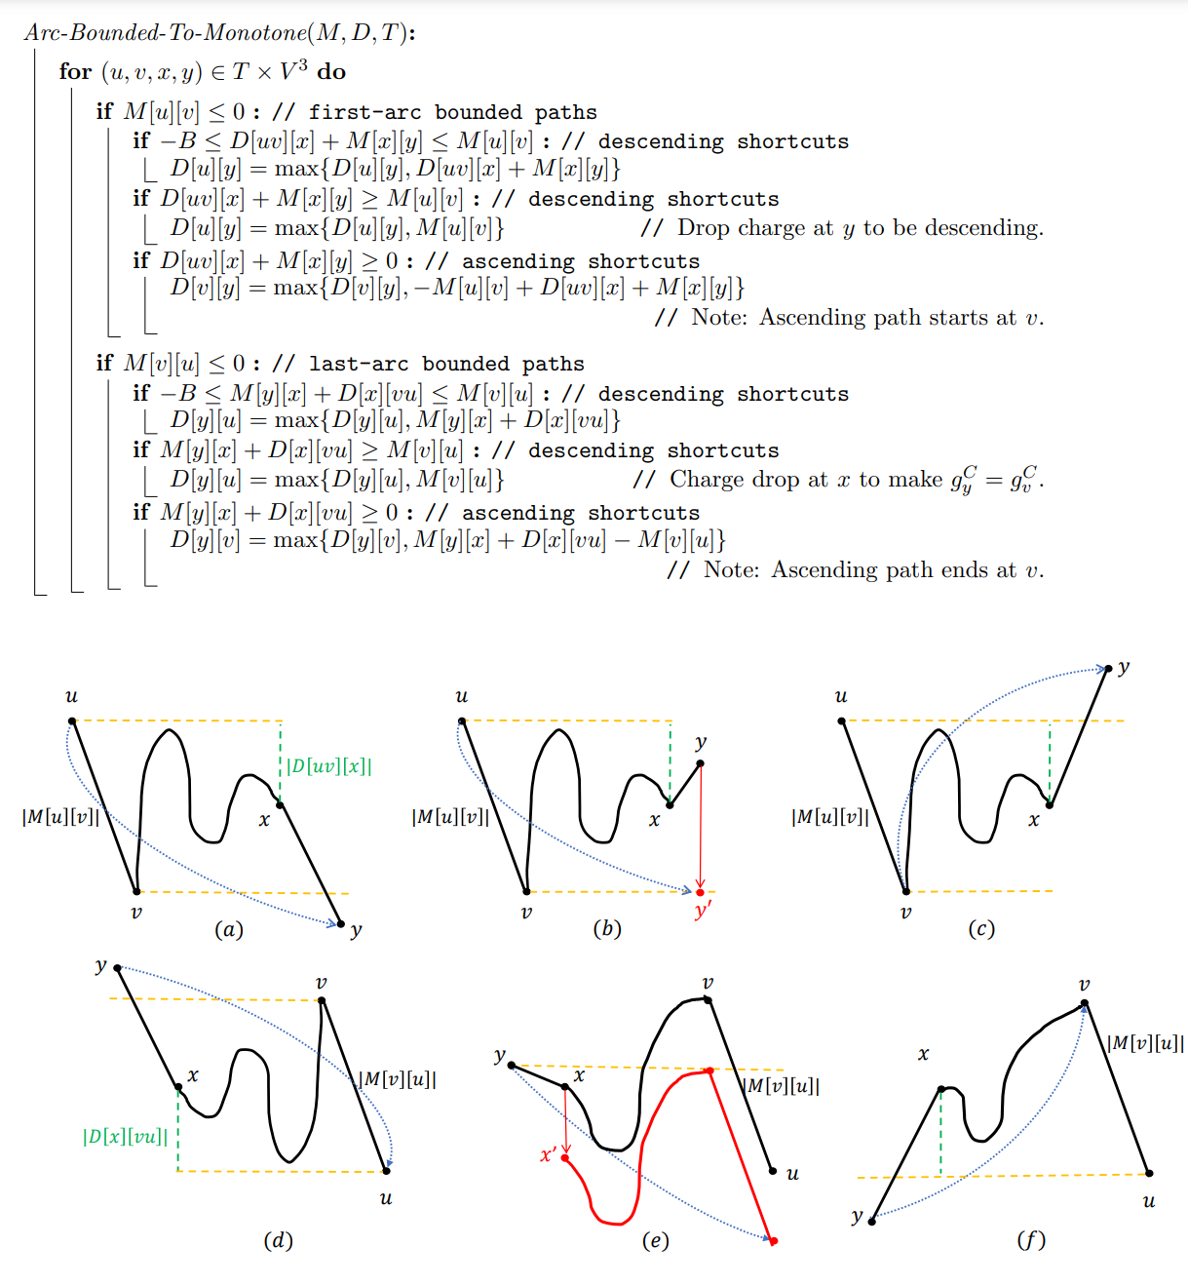
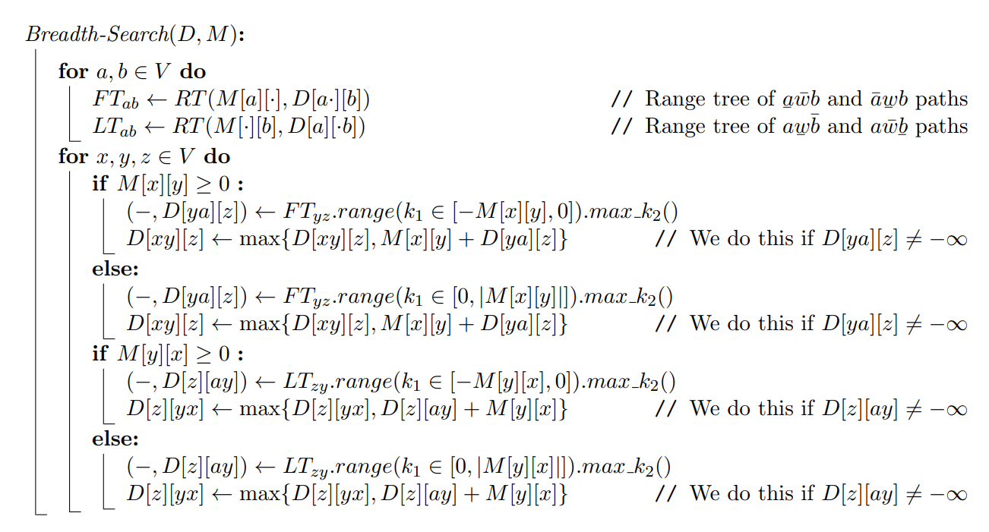
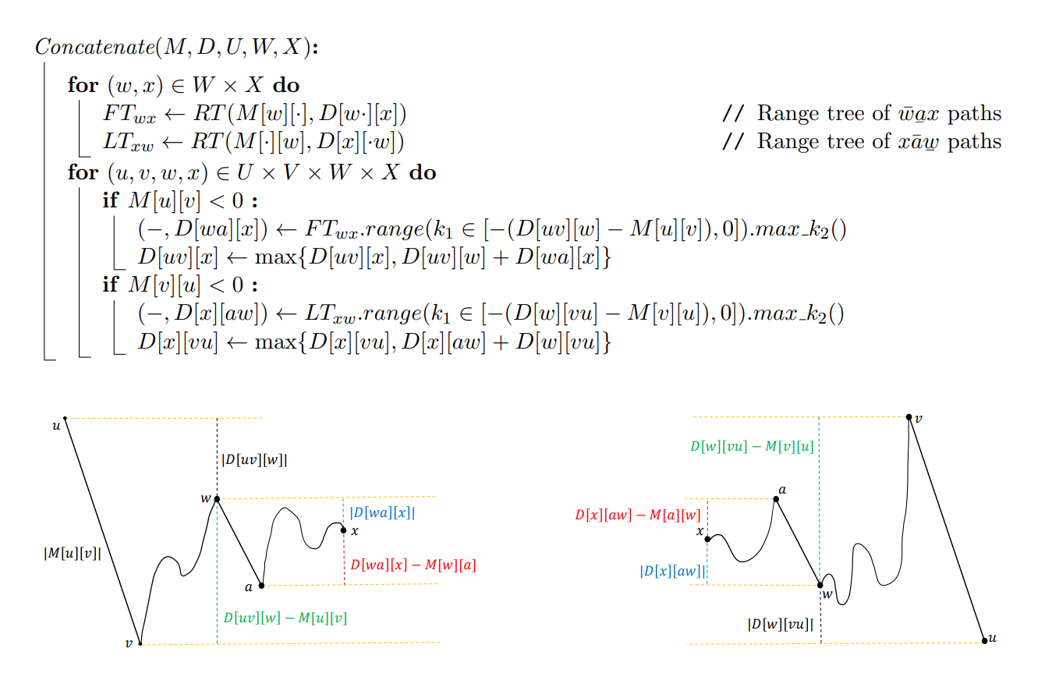
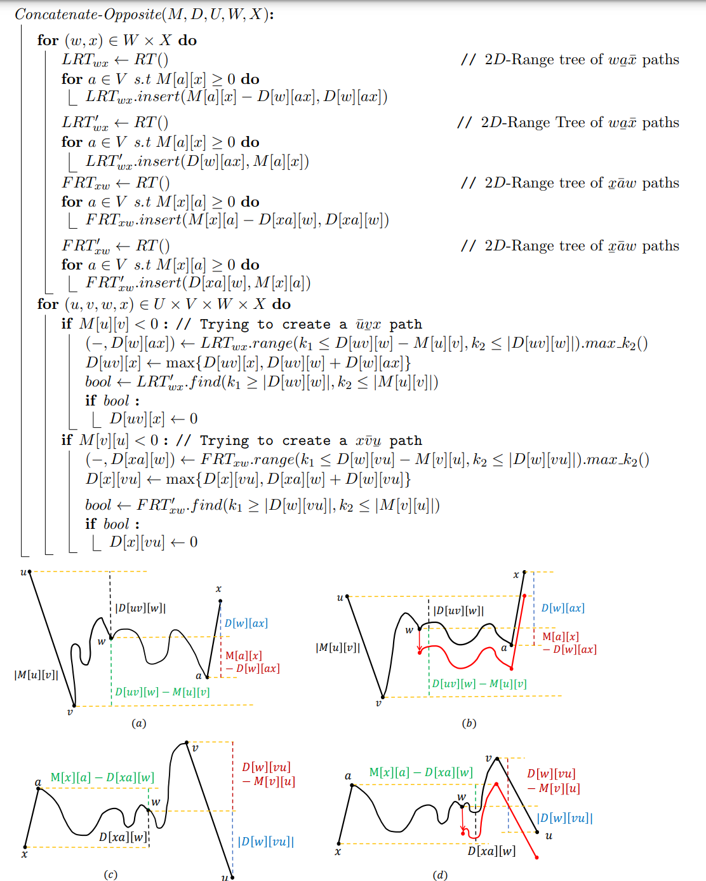
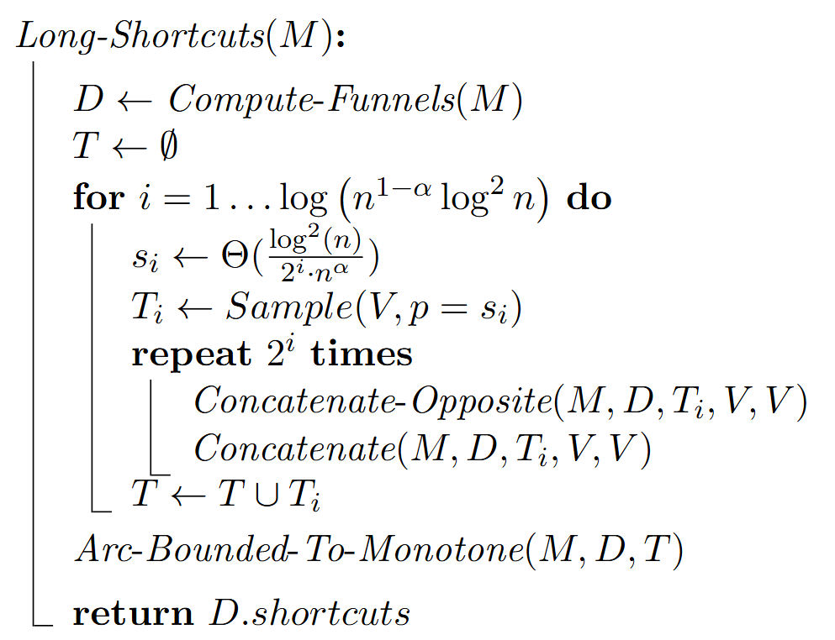
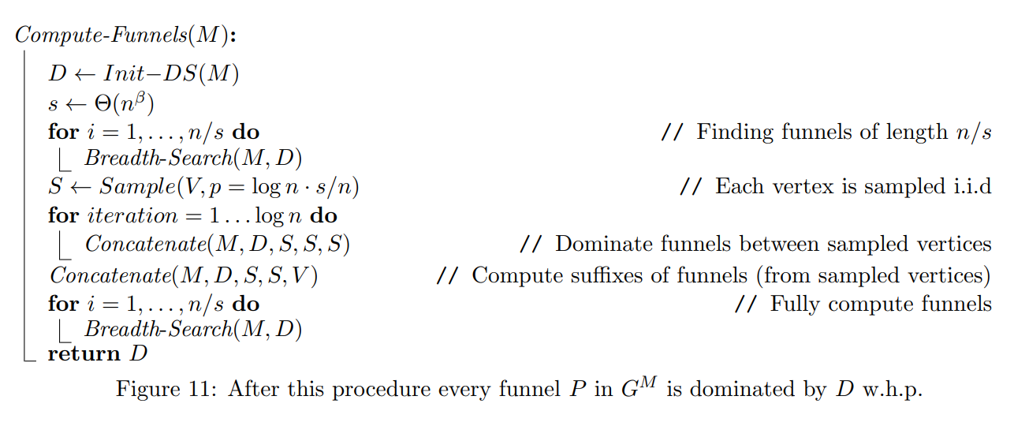
Finding long shortcuts

Slide 50
A technicality – Descending paths

Slide 51
A technicality – Descending paths

Slide 52
A technicality – Descending paths
New concept – Charge drops

Slide 53
Back to $α_{B}(s,t)$
$$P_{1}$$
$$P_{2}$$
$$P_{3}$$
$$P_{k}$$
$$P_{k+1}$$
$$B<∞$$
$$s$$
$$x_{1}$$
$$C_{1}$$
$$y_{1}$$
$$x_{2}$$
$$C_{2}$$
$$y_{2}$$
$$x_{k}$$
$$C_{k}$$
$$y_{k}$$
$$t$$

Slide 54
Computing all entry-exit pairs
Claim: Let $C$ be a positive cycle. There exists an entry-exit pair $(x,y)$ s.t $C^{xy}$ is ascending and $C^{yx}$ is descending.
Proof:
Let $(x^{′},y^{′})$ be any entry-exit pair. Set $y=y′$
$$C$$
Let $x$ be of smallest gain on $C^{yx^{′}}$
$$y$$
$$…$$
$$y$$
$$x′$$
$$y$$
$$x$$
$$x′$$
$$x$$
$$x$$
$$x′$$
$$x′$$
$$3$$
Notes:
The problem is not symmetric single source != single target

Slide 55
The computation of $α_{B}(s,t)$
Let $s′$ be the last vertex on an optimal $s$-$t$ path that is reached with full charge
$$s$$
$${s′=v}_{i_{1}}$$
$$v_{i_{3}}$$
$$v_{i_{7}}$$
$$v_{i_{5}}$$
$$=$$
$$t$$
$$t$$
A funnel!
$$v_{i_{6}}$$
$$v_{i_{4}}$$
$$v_{i_{2}}$$

Slide 56
Open problems
Achieve $\tilde{O}(n^{3})$ running time for the all-pairs problem.
Improve single-target $α\left(⋅,t\right)$ (or single source $β(s,⋅)$) running time in the case where there are no positive cycles.
Interesting setting: Vertices are charging stations – compute minimum cost paths.
Known results for all-pairs.
Single-source and single-target are open.

Slide 57
Thank you for your attention!

